Slide 1
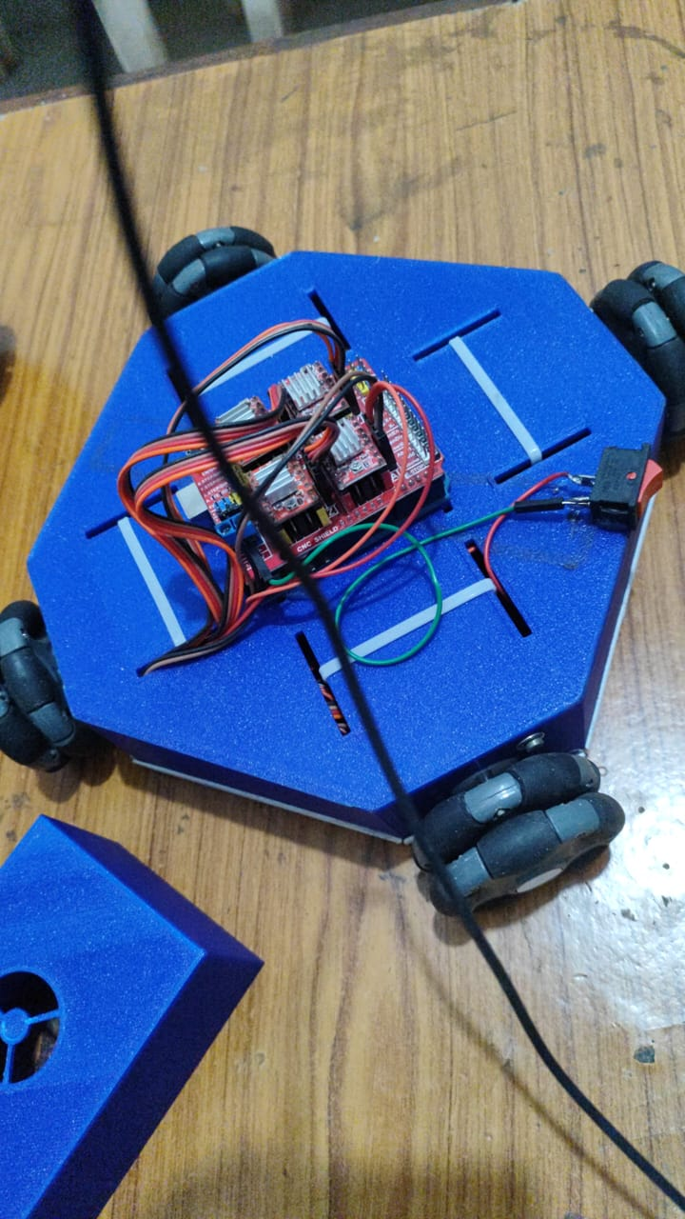
PATH PLANNING OF A WHEELED MOBILE ROBOT
BY:
Kamireddi Manohar
Aditya University

Slide 2
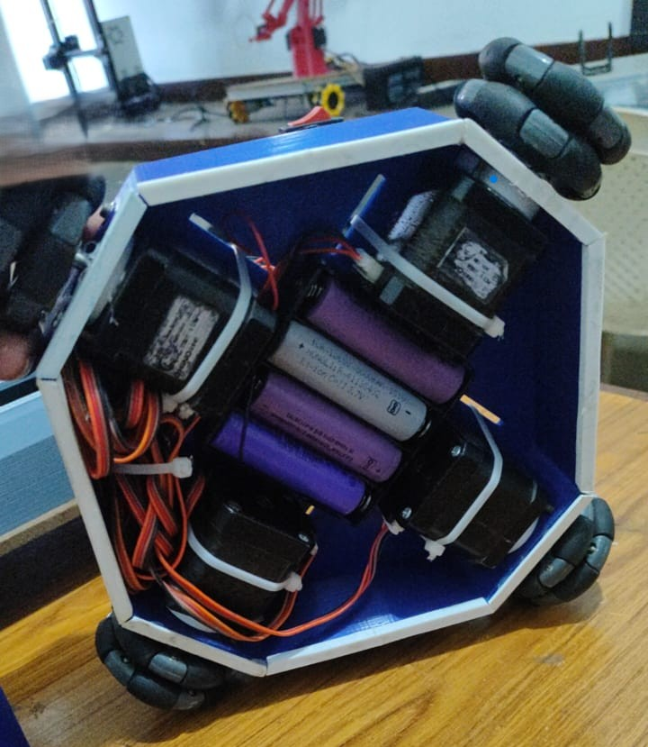
OBJECTIVES
To plan a path for a mobile robot to travel from an initial position to a final destination while avoiding predetermined obstacles.
To introduce and implement an algorithm-based control system for the robot that operates without sensors or cameras.
To use specific software (MATLAB for programming and Arduino for coding) to control the robot's movements and guide it along a predetermined path defined by Cartesian coordinates.
To ensure the robot follows the shortest path to save time and reduce maintenance and travel costs.

Slide 3
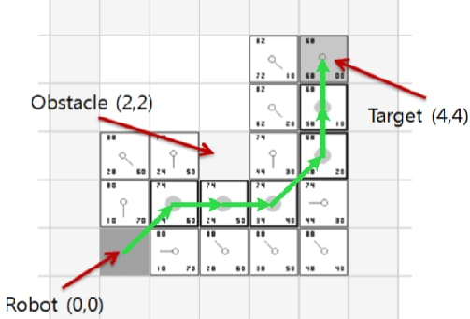
INTRODUCTION
A wheeled mobile robot navigating predetermined obstacles without sensors relies on algorithmic approaches for path planning and obstacle avoidance. One such method is using a pre-mapped environment and a predefined path for the robot to follow. Algorithms like Dijkstra's or A* can be employed to determine the optimal path through the given space, considering the predetermined obstacles. The robot's control system then executes the planned trajectory without real-time sensor feedback.
SHORTEST PATH THAT DODGING THE PREDETERMINED OBSTACLES USING A* ALGORITHM

Slide 4
1. Map Representation:- Digitize the environment with a grid, where each cell corresponds to a portion of space. Mark obstacle cells as occupied and free cells as unoccupied.
2. Starting Point:- Identify the initial position of the robot on the grid.
3. Goal Position:- Specify the destination for the robot within the grid.
4. Path Planning Algorithm:- Implement a basic algorithm such as the "Left-Hand Rule" or "Right-Hand Rule." In the Left-Hand Rule, the robot follows the left side of obstacles. If a left turn is blocked, it takes a right turn.
5. Obstacle Detection:- Simulate obstacle detection without sensors by relying on the predetermined obstacle locations in the map. The algorithm should guide the robot to navigate around obstacles without using real-time sensor input.
6. Movement Control:- Develop control mechanisms for the robot to execute the planned movements, like turning left or right, moving forward, and stopping.
7. Iterative Execution:- Continuously apply the algorithm iteratively until the robot reaches the predefined goal. Each iteration updates the robot's position based on the planned movements.

Slide 5
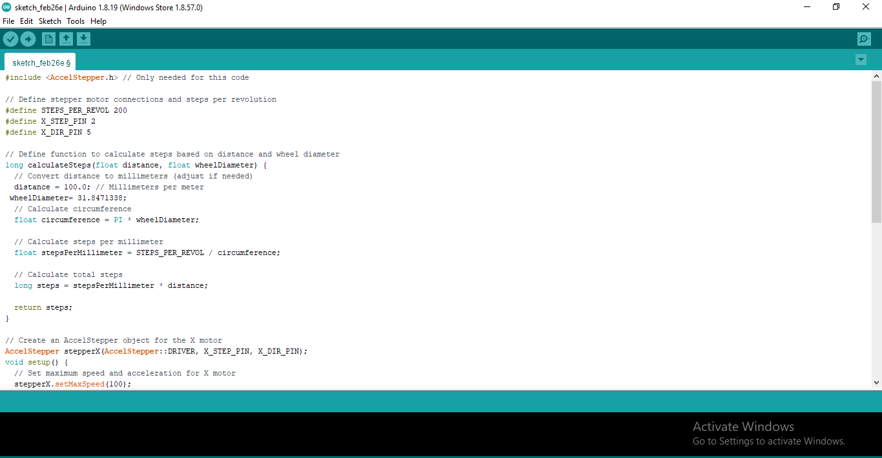
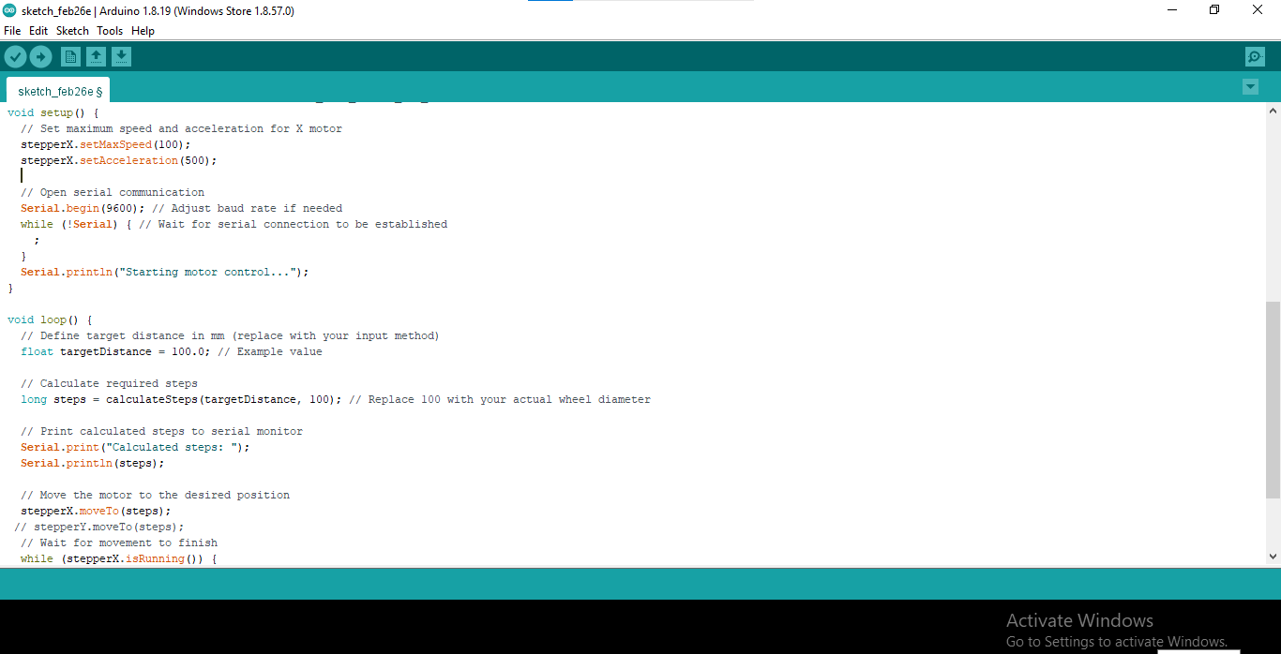
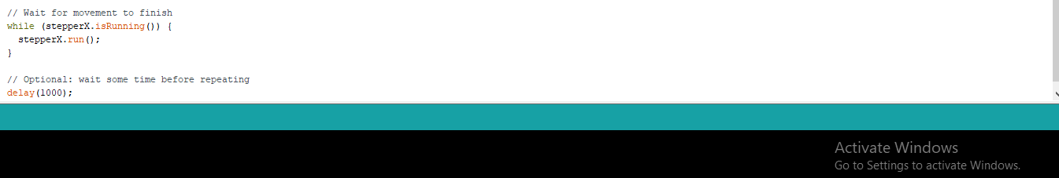
CODE FOR RUNNING A SINGLE STEPPER MOTOR

Slide 6
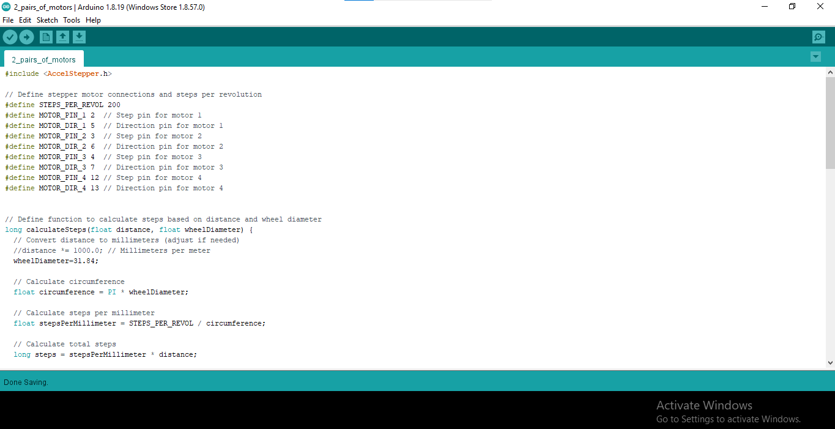
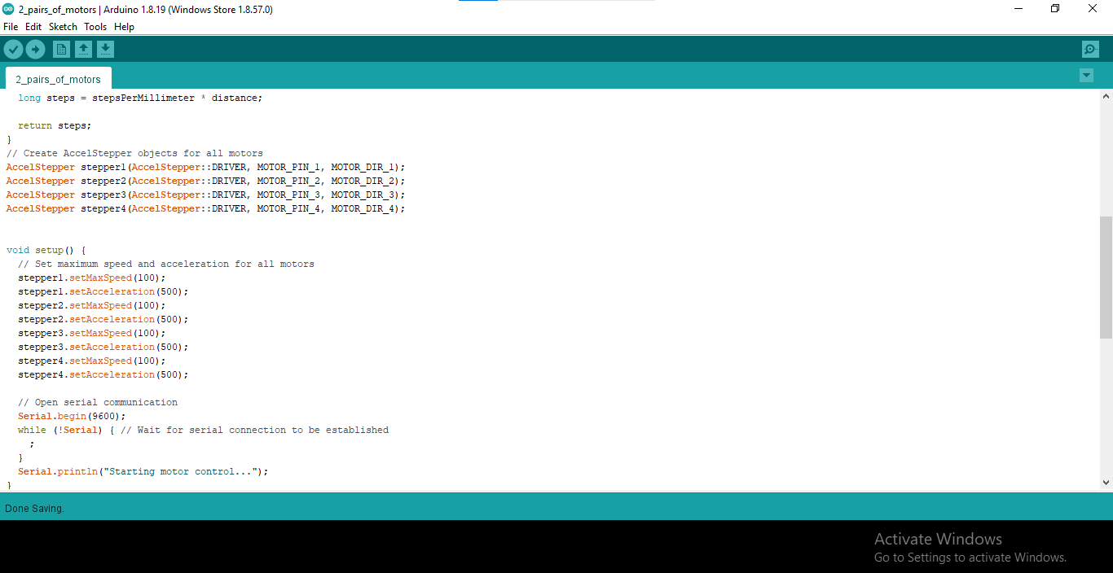
CODE FOR RUNNING Z-AXIS AND X-AXIS MOTORS INDIVIDUALLY

Slide 7
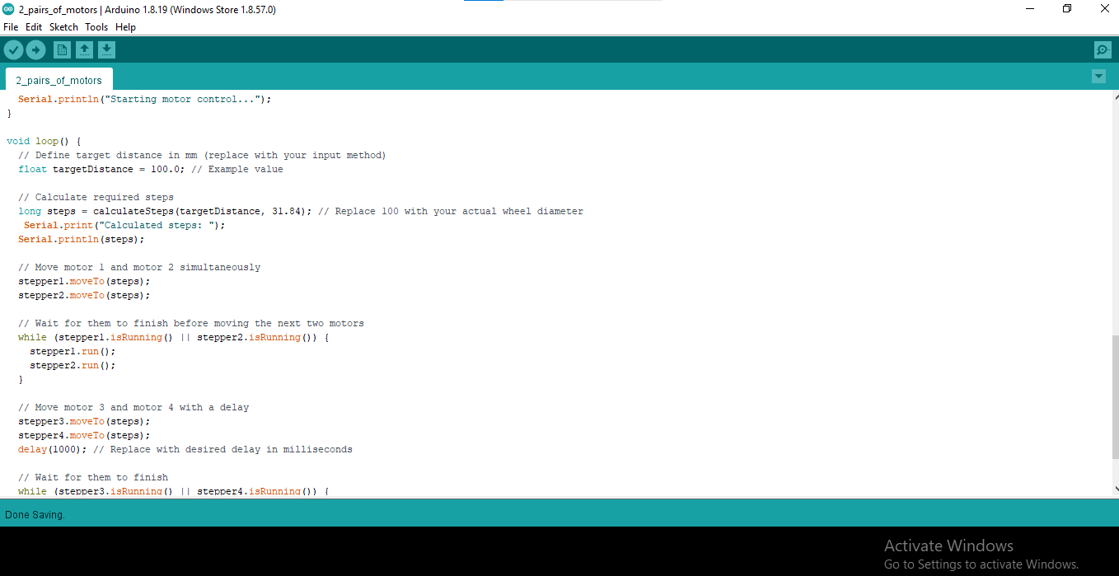
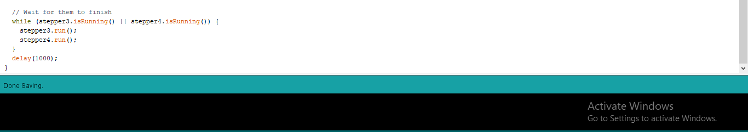

Slide 8
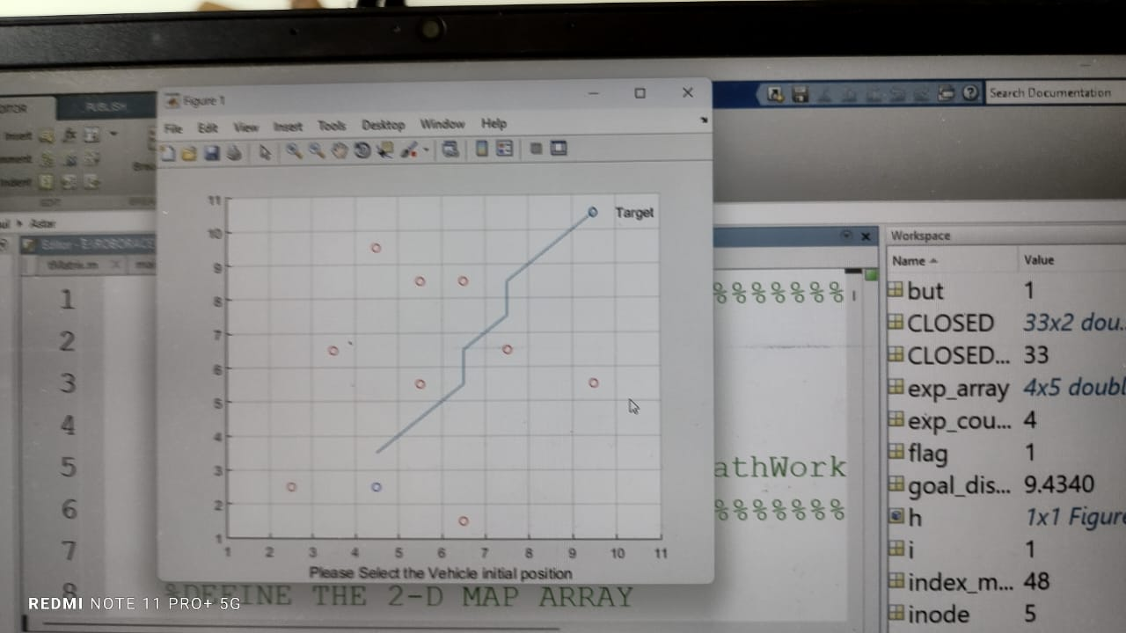
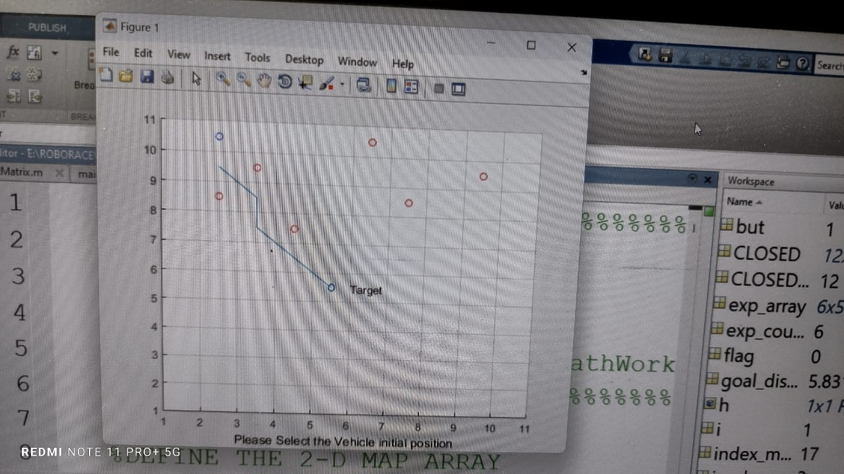
IMPLEMENTATION OF A* ALGORITHM IN MATLAB SIMULATION
At first we need to dump the A* algorithm in the MATLAB Software in order to get the simulated results.
After that we have to open the A* algorithm in MATLAB Software.
Now we need to select the initial position in the grid map, In which grid cell we want to start the travel of our robot.
Then fill a few cells in which we want to place the obstacles as obstacle cell.
Finally select the destination / goal position, At which the robot needs to reach at the end.
After all these steps, the A* algorithm will give the shortest path through the MATLAB Software.

Slide 9



